Slide 1
COLLECTION
JAVA

Slide 2
Architecture to store and manipulate the group of objects.
Operations such as searching, sorting, insertion, manipulation, and deletion.
Single unit of objects
Many interfaces (Set, List, Queue, Deque) and classes (ArrayList, Vector, LinkedList, PriorityQueue, HashSet, LinkedHashSet, TreeSet).

Slide 3
What is a framework in Java?
It provides readymade architecture.
It represents a set of classes and interfaces.
It is optional.

Slide 4
WHAT IS COLLECTION FRAMEWORK?
Unified architecture for storing and manipulating a group of objects.
It has:
Interfaces and its implementations, i.e., classes
Algorithm

Slide 5
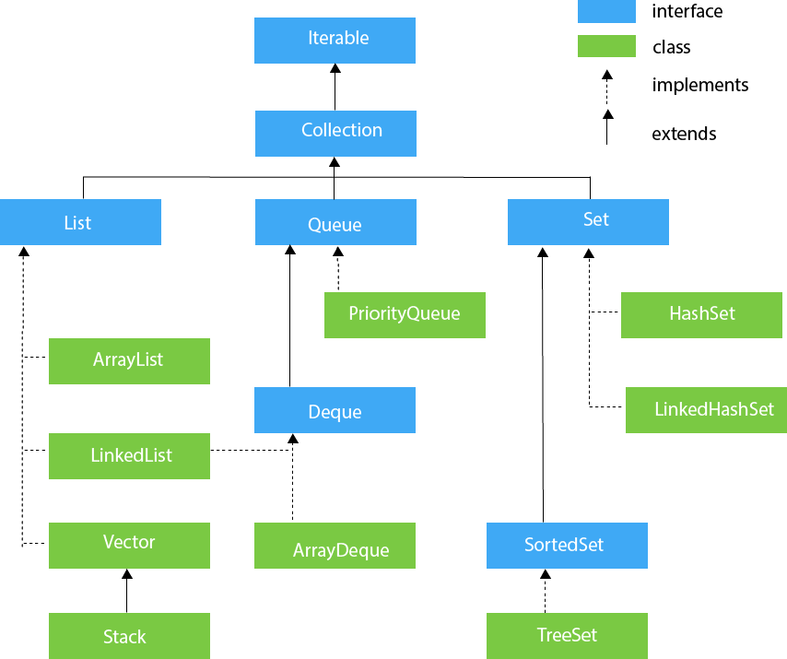
HIERARCHY OF COLLECTION FRAMEWORK

Slide 6
LIST INTERFACE
It can have duplicate values.
List interface is implemented by the classes ArrayList, LinkedList, Vector, and Stack.
Store the ordered collection of objects.

Slide 7
To instantiate the List interface, we must use :
List <data-type> list1= new ArrayList();
List <data-type> list2 = new LinkedList();
List <data-type> list3 = new Vector();
List <data-type> list4 = new Stack();

Slide 8
SET INTERFACE
Set Interface is in java.util package.
It extends the Collection interface.
Unordered set of elements
Doesn't allow us to store the duplicate items.
Store at most one null value in Set.
Set is implemented by HashSet, LinkedHashSet, and TreeSet.

Slide 9
Set instantiated as:
Set<data-type> s1 = new HashSet<data-type>();
Set<data-type> s2 = new LinkedHashSet<data-type>();
Set<data-type> s3 = new TreeSet<data-type>();

Slide 10
MAP
A map contains key and value pair.
Each key and value pair is known as an entry.
unique keys.
Used to search, update or delete elements on the basis of a key.

Slide 11
A Map doesn't allow duplicate keys,
You can have duplicate values.
HashMap and LinkedHashMap allow null keys and values
TreeMap doesn't allow any null key or value.

Slide 12
HASHMAP is the implementation of Map, but it doesn't maintain any order
LINKEDHASHMAP is the implementation of Map. It inherits HashMap class. It maintains insertion order.
TREEMAP is the implementation of Map and SortedMap. It maintains ascending order

Slide 13
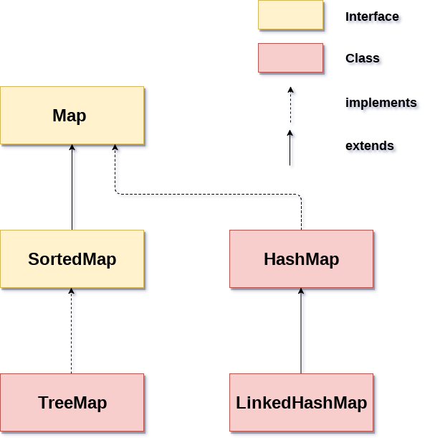
MAP HIERARCHY

Slide 14
EXAMPLES

